Slide 1
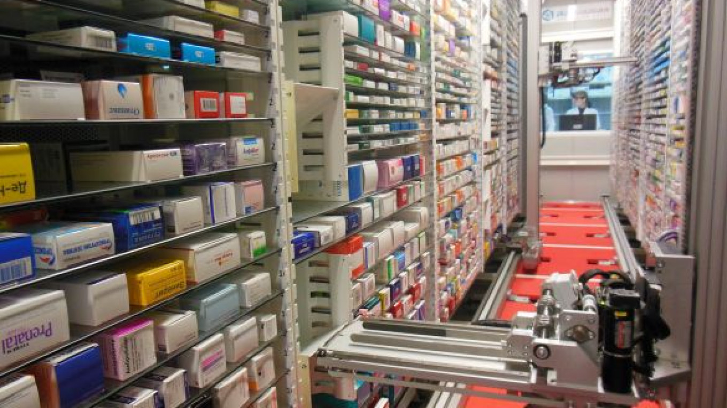
Can Adopting Data Science Help Local Pharmacies?
Stephen O’Connor

Slide 2
Abstract
This white paper is written with the intentions of proposing my idea of artificial intelligence into a local pharmacy business. I will be going through how a local pharmacy functions, how the pharmaceutical industry has been using data science, what my idea is, and how my idea can be an efficient way for a local pharmacy to be more profitable.

Slide 3
Introduction
Pharmaceutical Industry
Competition between local and chain pharmacies
Minimum Wage
Why own a local pharmacy?

Slide 4
How a pharmacy Functions
Types of data produced by the pharmacy
OTC information
Prescription information

Slide 5
Data Science In Pharmacy
Why people choose a local pharmacy over a chain one
How the data has been used
Cognitive Services in pharmacy
Artificial Intelligence in pharmacy

Slide 6
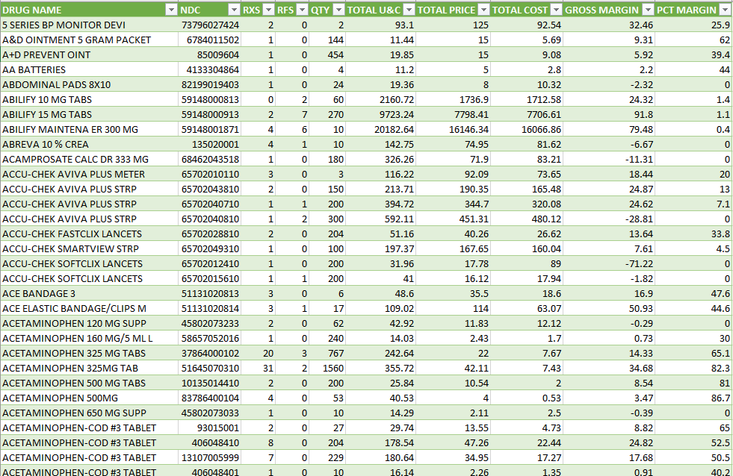
Proposal
Profit information
All Sale items
My idea

Slide 7
Discussion/Conclusion
Controversy that comes from my idea
The goal of my paper and my idea

Slide 8
Questions?

